Slide 1
ArtConnect India Uniting Culture Through E-Commerce
Team “Dragon”
Danda Vamsi Chakradhar Machiraju Karthikeya Manjunadha Vennampalli Venkateswarulu M Santosh Reddy Puvvada Vamsidhar

Slide 2
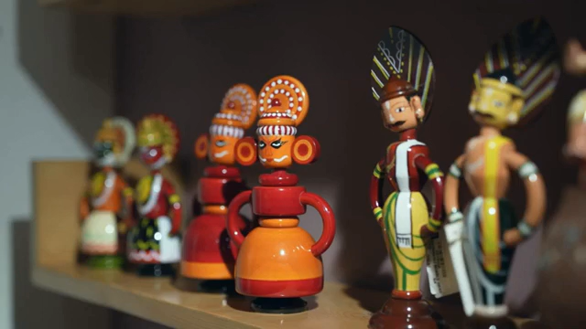
Documentary on Declining Traditional Arts of India

Slide 3
Introduction
India is home to a rich and diverse tradition of handicrafts, each reflecting the unique culture of different regions. From Pashmina weaving in Kashmir to Madhubani paintings in Bihar, these art forms are more than just crafts – they are a legacy passed down through generations. However, with the rise of mass production, e-commerce giants, and changing consumer preferences, these traditional art forms are struggling to survive.
Problem Statement
India's traditional handicrafts are struggling as artisans face low demand, unfair earnings, and limited digital reach. Middlemen take a significant share of profits, while mass-produced imitations make it harder for consumers to find authentic crafts. With financial insecurity and fewer opportunities, younger generations are moving away from these trades, putting many traditional art forms at risk of extinction and leading to a major loss of cultural heritage.

Slide 4
Uniqueness of Our Idea
Aggregator Model – Unlike individual artisan platforms, you partner with local websites, making it scalable.
Transparency with QR Codes – Customers can scan a QR code on each product to see the artist’s name, price paid, and creation date.
Cultural Storytelling – Each product page will feature the history, artisan profile, and making process of the art form.
No Inventory Handling – The platform operates as a middleman, ensuring lower operational costs.
State-Based Promotions – Partnered websites can run regional promotions, increasing sales of local art.

Slide 5
Importance of Our Idea
Preserving Cultural Heritage – Revives and sustains India’s traditional art forms.
Empowering Local Artisans – Provides a fair-trade platform ensuring direct profits.
Bridging the Digital Gap – Connects artisans with a wider online audience.
Enhancing Transparency – QR codes ensure authenticity, fair pricing, and artist recognition.
Boosting Economic Growth – Strengthens the handicraft industry, creating sustainable livelihoods.
Impact on Society
Increased Sales & Visibility – Local artisans get nationwide exposure, leading to higher demand.
Fair & Direct Earnings – No middlemen, ensuring higher profits for artisans.
Consumer Trust & Engagement – Storytelling and transparency build a deeper connection with buyers.
Encouraging Future Generations – Financial stability attracts younger artisans to sustain the craft.
Sustainable & Ethical Business – Promotes eco-friendly, handcrafted products over mass production.

Slide 6
Workflow
🔹 Step 1: Collaboration with Local Artisan Websites → Partner with existing local e-commerce websites that sell traditional handicrafts. → Integrate their product listings into our centralized platform for wider reach.
🔹 Step 2: Centralized Artistry Platform → Our website acts as a one-stop destination showcasing handicrafts from all partnered local websites. → Each product page includes: ✅ Cultural storytelling to engage buyers. ✅ QR Code ensuring authenticity, artisan details, and pricing transparency.
🔹 Step 3: Customer Orders the Product → Customers browse and place orders directly on our platform. → Order details (name, address, contact) are automatically forwarded to the respective local website.
🔹 Step 4: Order Processing by Local Websites → The partnered local website handles packaging and shipping directly to the customer. → We do not manage inventory, ensuring a lightweight, scalable model.

Slide 7
Workflow
🔹 Step 5: Secure Payment Distribution → 80-90% of the payment is transferred to the respective local website. → 10-20% is retained as a platform & promotional fee to sustain and grow the business.
🔹 Step 6: Marketing & Promotions → We provide free and paid promotions for partnered websites by: ✅ Running targeted social media & influencer campaigns. ✅ Boosting specific crafts based on festivals, trends, and state-wise promotions. ✅ Enhancing SEO & digital reach to drive traffic to the products.
🔹 Step 7: Scaling & Expansion → Onboarding more local websites from different states to expand product variety. → Encouraging regional digital adoption for artisans via website integrations.

Slide 8
Feasibility and Scalability
Growing Market for Handmade Products – The Indian handicraft market is expected to grow at 10% CAGR due to increasing demand.
Low Operational Costs – No need to manage warehouses or logistics, reducing overhead costs.
Tech Integration Possible – SAP Commerce Cloud, Shopify, or custom development can support the aggregator model.
Government Support – Initiatives like Make in India, TRIFED, and ODOP (One District One Product) can help in artisan onboarding.
Expand Partnerships – Onboard more local websites across states.
AI & Mobile App – Smart recommendations & better accessibility.
Global Reach – Enable international shipping.
Festival & Influencer Marketing – Boost sales through seasonal & social media campaigns.

Slide 9
Competitive Analysis
Feature | Our Platform | Craftsvilla | Amazon Karigar | India Craft House
Aggregator Model | Partners with local sites | Own inventory | Direct Sales model | Direct Artisan sales
Transparency (QR Code) | Yes | No | No | No
Cultural Storytelling | Yes | Limited | Limited | Yes
State Wise Promotions | Yes | No | No | No
Global Reach | Yes | Yes | Yes | Yes
Fair Artisan Payment | Directly Visible to customers | Indirect | Indirect | Direct but no Transparency

Slide 10



